Slide 1


Slide 2
Teaching and Technology Bandwagons:
Where are they now?
Wally Nolan & Larry MacPhee
e-Learning Center

Slide 3
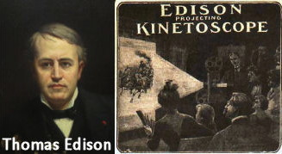
“Books will soon be obsolete in the public schools. Scholars will be instructed through the eye. It is possible to teach every branch of human knowledge with the motion picture. Our school system will be completely changed inside of ten years.”
-Thomas Edison, 1913

Slide 4
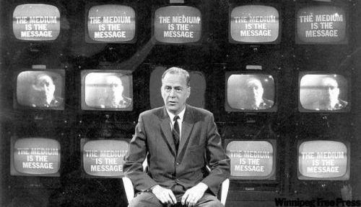
“Our entire educational system is reactionary, oriented to past values and past technologies, and will likely continue so until the old generation relinquishes power. The generation gap is actually a chasm, separating not two age groups but two vastly divergent cultures. I can understand the ferment in our schools, because our educational system is totally rearview mirror. It’s a dying and outdated system founded on literate values and fragmented and classified data totally unsuited to the needs of the first television generation.”
-Marshall McLuhan, 1969

Slide 5
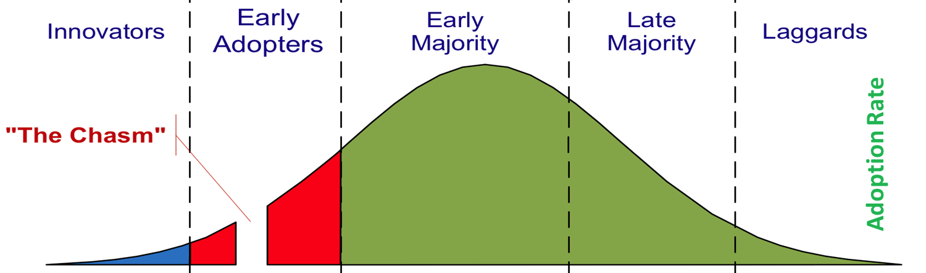
The Technology Adoption Curve
Where are you?
Notes:
Where do you fall on the curve? Always in the same place? (Tech Adoption Curve came out of agricultural research in early 20th century)

Slide 6
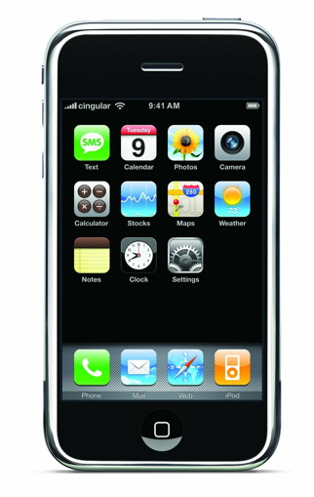
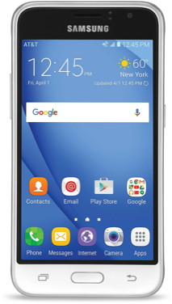

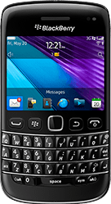
POP QUIZ: WHAT DID YOUR FIRST SMARTPHONE LOOK LIKE?
Palm Treo
Blackberry
iPhone
Android
Innovator
Early Adopter
Early Majority
Late Majority
If you still don’t own a smartphone, no offense, but you’re a laggard! ☹

Slide 7
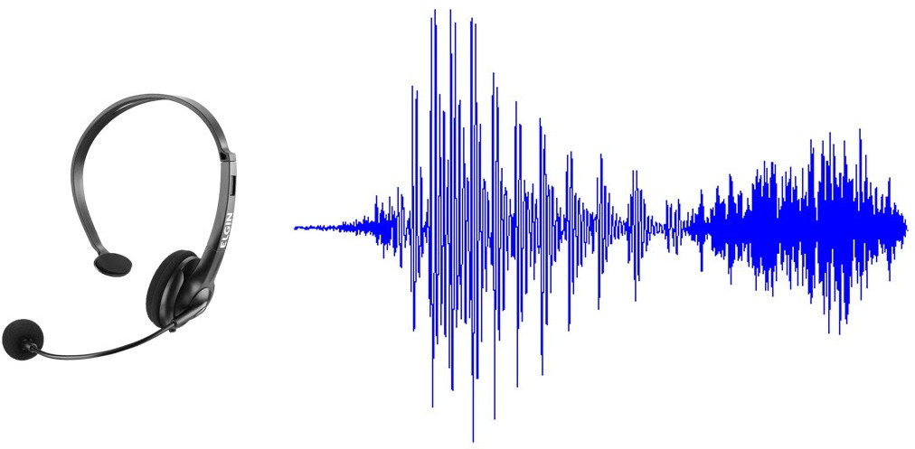
Think about A TECHNOLOGY LIKE SPEECH RECOGNITION
Notes:
From 1960s sci-fi, to a 1990s party game, commercialized in the 2000s as a disability aid (Dragon), it is now finally becoming mainstream (Siri, Alexa, etc.)

Slide 8
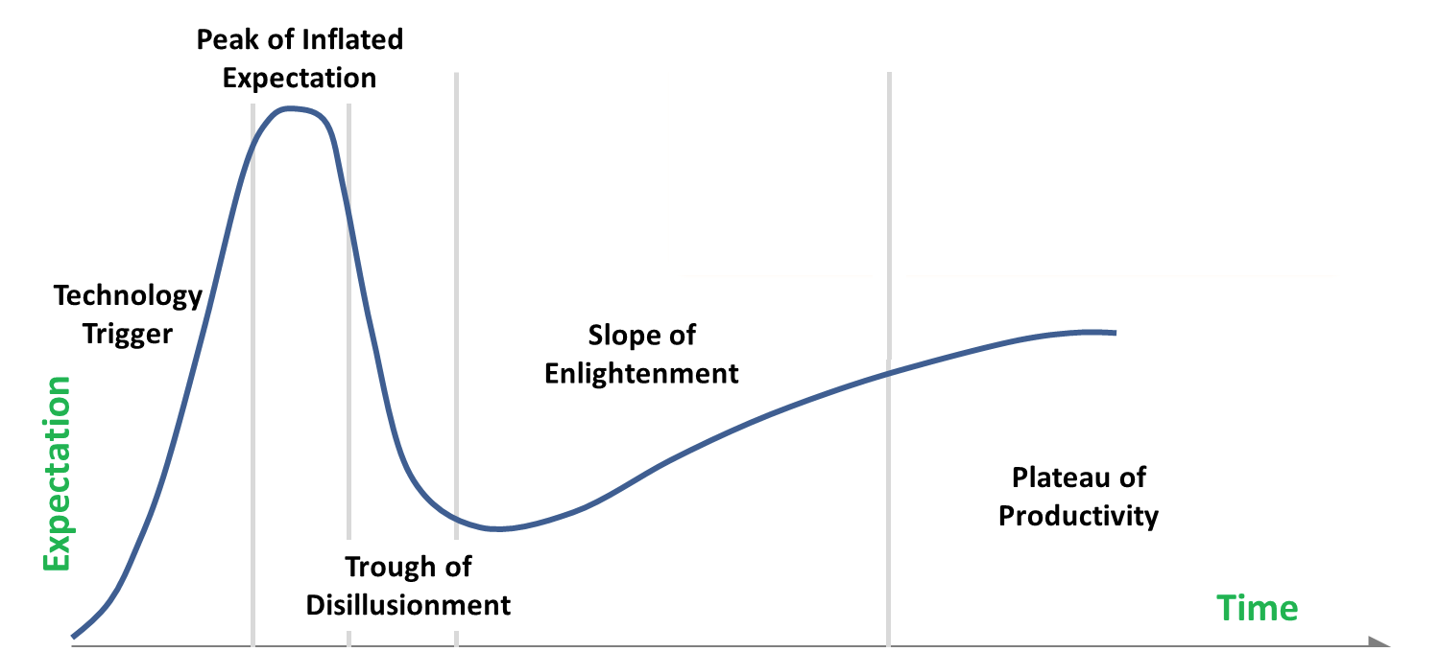
The Hype Cycle
Notes:
Speech recognition leaped the chasm, survived the jokes, found a niche, and has gradually improved and become more useful.

Slide 9
Let’s OVERLAY THOSE GRAPHICS

Slide 10
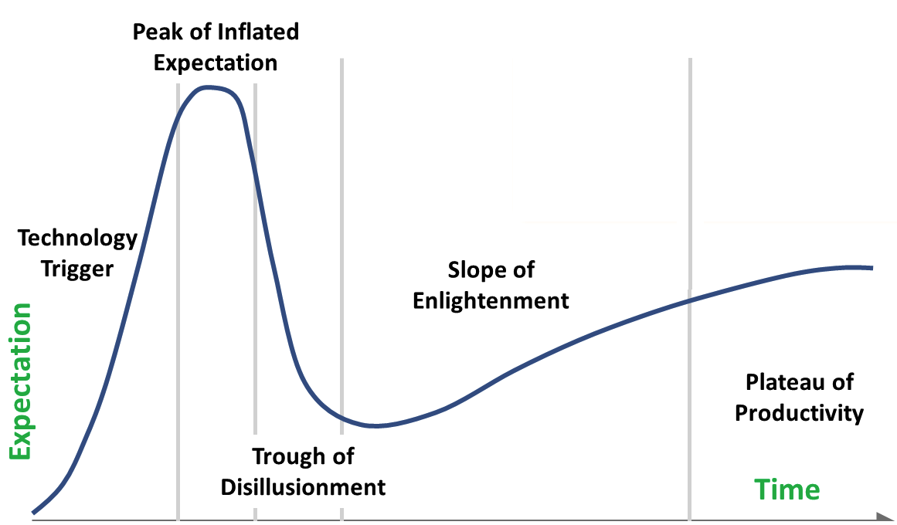
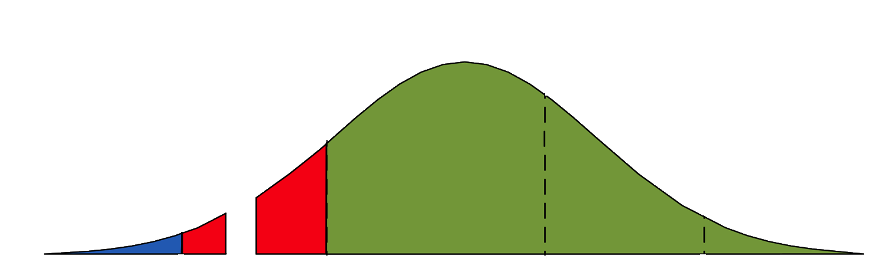
Notes:
Note how the Inflated Expectations peak overlaps with the Chasm! A lot of technology never makes it across the gap.

Slide 11
“The CHASM”
Many promising technologies disappear into the chasm and are never seen again. Can you think of some educational examples? The technology could be hardware, software, a service, or some combination.
Why did they fail to catch on?
Product incomplete, buggy
Product too complex for mass appeal
Product misapplied
Product over-promised and/or under-delivered

Slide 12
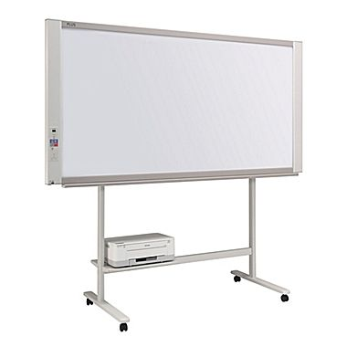
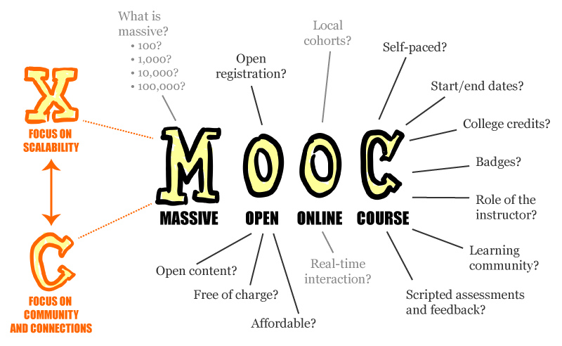
Caught in the Chasm?
Smartboards

Slide 13
The SlOPE OF ENLIGHTENMENT
&
The PLATEAU OF PRODUCTIVITY
If a technology jumps the chasm, it will be given a chance to mature, will gradually gain followers and become widely adopted.
Can you think of some educational examples?

Slide 14
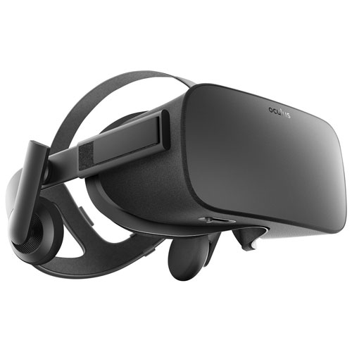
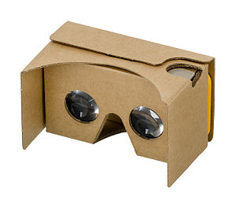
Virtual Reality (VR) Hardware
Google Cardboard
Oculus Rift
Notes:
Google Cardboard, Oculus Rift

Slide 15


Virtual Worlds
Second Life
Minecraft Edu
Notes:
Second Life, MineCraft, RoBlox, multi-user worlds to explore

Slide 16
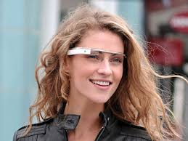
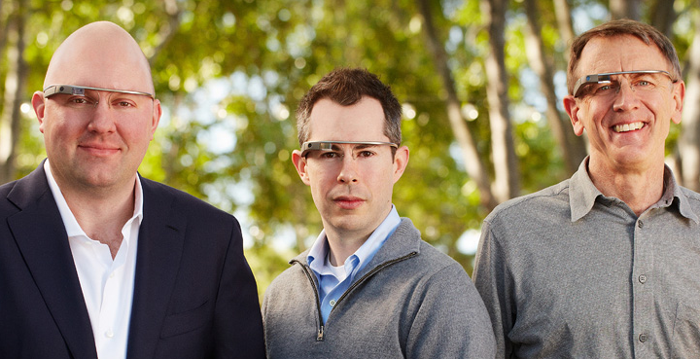
Augmented Reality
Google Glass: Marketing vs Reality
Admented Reality

Slide 17


Classroom Initiatives: iPads & Chromebooks

Slide 18
More!
Clickers & Polling
Flipped Classroom
Internet of Things (IoT)
Gamification
Predictive Analytics
Blended Hybrid Instruction
Adaptive Courseware
Badging

Slide 19
Questions & Comments?

